Slide 1
PERIODIC CLASSIFICATION OF ELEMENTS PART-1 : DOBEREINER’S TRIAD, NEWLANDS’LAW OF OCTAVES
CHAPTER 5

Slide 2
Introduction
What is a periodic table?
Total elements are 118 and 94 are natural.
Notes:
Slide: 2
Welcome.
Today, we’re here to talk about Periodic Classification of Elements. In class IX, we have learnt that matter around us is present in the form of elements, compounds and mixtures. There are 118 elements which have different properties are known to mankind. Out of these, 94 are naturally occurring while the remaining 24 are synthetic.

Slide 3
Classification of Elements
1. Dobereiner’s Triad
2. Newland’s Law of octaves
Notes:
Slide: 3
As there are a variety of elements, scientists have been finding ways to classify them according to their properties. Two of the classifications are:
Dobereiner’s Triad,
Newland’s Law of Octaves

Slide 4
Dobereiner’s Triad
Elements are arranged in threes.
Known as Triads
Written in ascending order of masses.
Notes:
Slide: 4
In the year 1817, Johann Wolfgang Dobereiner, a German chemist, arranged elements of similar properties together in threes. He called these groups ‘triads’. He stated that the triads were written in the ascending order of masses and the atomic mass of the middle element was approximately the average of the atomic masses of the other two elements.

Slide 5
What is Atomic Mass?
Atomic Mass = Protons+Neutrons
Example:
Number of protons in O = 8
Number of neutrons in O = 8
Atomic mass of O => 8+8 => 16
Notes:
Slide: 5
The question here is, what is atomic mass?
It is nothing but the sum of total number of protons and neutrons of an atom.
For Example, In the Oxygen element, (O), the number of protons are 8 and the number of neutrons are also 8. Thus, the total number of protons and neutrons would be 8+8, which is 16.
Thus, the atomic weight of oxygen is 16.

Slide 6
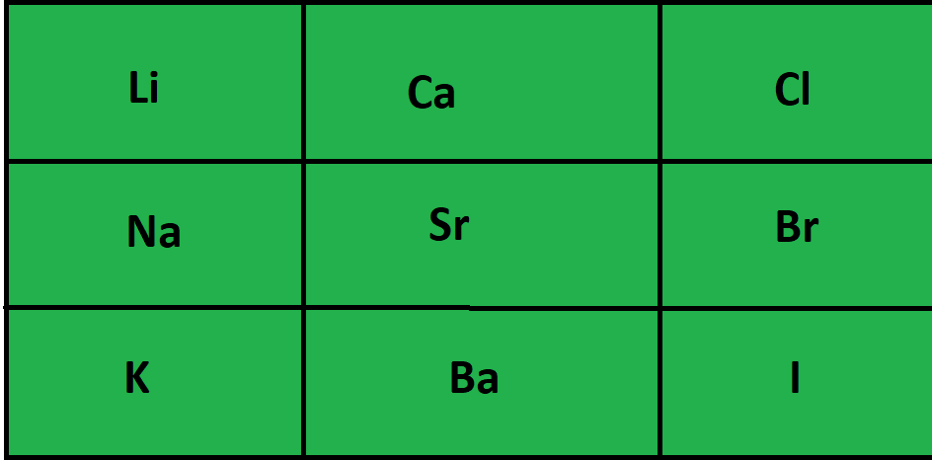
Notes:
Slide: 6
Now let us understand dobereiner’s triad clearly with an example. Consider the following table:
Here, Li, Ca, and Cl is one triad. Na, Sr, and Br is the second triad and K, Ba and I is the third triad. The atomic mass of Lithium is 7, Sodium is 23 and potassium is 39. The mean atomic weight of Lithium and potassium is 23, which is equal to the atomic weight of Sodium.
Animate atomic masses of respective elements and their mean atomic weights
Similarly, the mean atomic weight of Calcium and Barium is 88.75, which is equivalent to the atomic weight of Strontium, 87.5.
Animate atomic masses of respective elements and their mean atomic weights again

Slide 7
Drawback
It is applicable only for a few elements.
Notes:
Slide: 7
The drawback of this classification is that this was implemented only when a few elements were known to man. In present life, there are more than just a few elements. So, this classification cannot be used anymore.

Slide 8
Newlands’ Law of Octaves
Every eight element is similar.
Notes:
Slide: 8
When dobereiner triads failed, John Newlands, in 1865, tried to arrange the elements in increasing atomic weight. He noticed that every eight element of the table have the similar physical and chemical properties.

Slide 9
sa | re | ga | ma | pa | da | ni
H | Li | Be | B | C | N | O
F | Na | Mg | Al | Si | P | S
Cl | K | Ca | Cr | Ti | Mn | Fe
Co and Ni | Cu | Zn | Y | In | As | Se
Br | Rb | Sr | Ce and La | Zr | - | -
Notes:
Slide: 9
This is the table made by Newlands
If you look at the table, the eight element from lithium (li) is sodium (Na), thus, they have similar properties. Likewise, The eight element from Sodium (Na) is Potassium (K) and they possess similar properties.
Similarly, the eight element from Fluorine (F) is Chlorine (Cl), and they are said to have similar properties. This is how Newland’s Octaves work.

Slide 10
Drawbacks
Can be applied only till Calcium (Ca).
A proper place for hydrogen was not assigned.
Two elements were put in the same slot.
No space was allocated for the new elements.
Notes:
Slide: 10
Every periodic table ever created always have a drawback. A few of Newlands’ table’s drawbacks are as follows
This theory can be applied only till Calcium (Ca). From there, every eight element do not possess similar properties.
If you had noticed, we never calculated the eight element from hydrogen. This is because a proper place for hydrogen was not assigned by Newlands.
(Go to slide 10 and show the table and point H)
Two elements were put in the same slot. That is, Co and Ni are put in one slot and Ce and La are put in one slot together, which is not supposed to be done.
(Go to slide 10 and show the table and point ‘Co and Ni’, while saying the first part and point ‘Ce amd La’ while describing second part)
The elements that were discovered later could not be put in the table.
To overcome these issues, a scientist named Dimitri Mandaleeve came up with mandaleeve’s periodic table, which will be discussed in the next video

